Slide 1

Presenter best practices
Presenter
Before your event
78

Slide 2
Presenting with ease
Optimize your content for digital delivery
Identify your central message.
Have a clear call to action within your presentation.
Prepare content that you are familiar with and uses both text and visual images.
Do not read your slides to the audience. Use a bullet point format and add value with your expertise.
New! Use the PowerPoint Presenter Coach to evaluate your presentation delivery.
Review settings under the Slide Show menu (if using PowerPoint) to customize your defaults.
Rehearse timing to ensure you can adequately cover your content in the time provided (Slide Show | Rehearse Timings command).
Consider putting housekeeping and resource slides at the beginning when you have people’s attention, so you do not disrupt Q&A toward the end of your session.
Ask your organizer how and where to share your final materials with your audience.
79
© Microsoft Corporation
Microsoft 365

Slide 3

Example: Building a 30-minute digital breakout
Focus your message
Be concise
Use demos to show your point, but don’t be afraid to short cut
Deliver the roadmap for ongoing engagement (skilling, online support, other programs)
Use the rehearsals for feedback
Prepare lead-in questions to get the Q&A started
Session flow
Time (min) | Description | Owner
1 | Introduce presenter and set expectations about the session. | Moderator
10-15 | Session content delivery, including slides, demos and call to action | Presenter
15-19 | Open Q&A, questions will be read and answered for attendees | Presenter/ Moderator
80
© Microsoft Corporation
Microsoft 365

Slide 4


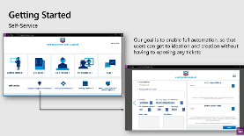
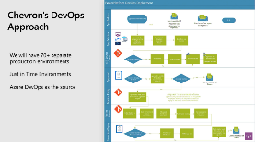

Presentation structure
This simple outline shows how the parts of your presentation will be combined before being presented to your audience. Some elements will be added by the post-production team before distribution.
1. Opening slate
2. Video greeting
3. Core content
10-second opening title that includes event branding, session title and your name/title/social contact information.
Overview of what will be presented. Recorded via Windows Camera, Mac tools or other 3rd party app. Key Learning: Let your audience visually connect with you as you start.
Recorded via PowerPoint screen record feature or other 3rd party app. Can be concurrent with opening.
4. Core content – cont’d
5. Short conclusion
6. End slate
Continued content from PowerPoint.
Call to action or pointer to resources. Recorded via Windows Camera App or other 3rd party tool. Key Learning: Connect with your audience visually at the end of your presentation.
Branded ending slate. Use an end slide that is appropriate for your organization.
81

Slide 5
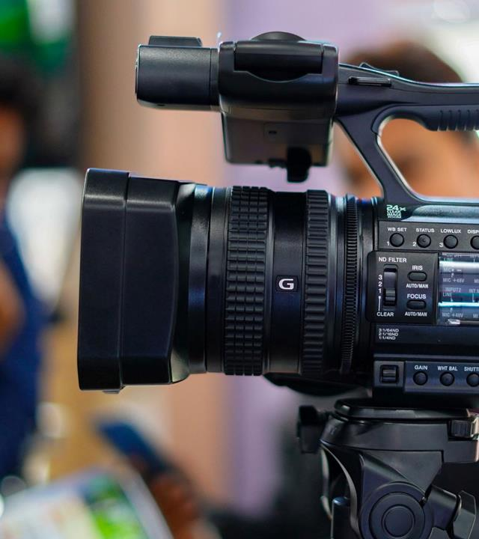
Equipment and Environment
Your equipment
External Microphone: Audio is the most important portion of your presentation. You should plan to have a microphone that is external to your computer. Avoid using laptop speakers/microphones for the best audio.
Web Camera: Select a web camera that delivers a minimum 720p (ideally 1080p) resolution. Position camera at or slightly above eye level
Test it! Ask for a rehearsal time or schedule your own Live Event/Teams meeting to test the process. Use the test call feature in Microsoft Teams to record a voicemail that will playback to you so you can hear your own voice.
Lighting: If you will be frequently presenting, consider getting a stand-alone LED light that will provide you with a higher quality image on video. Avoid sitting where there is heavy backlighting.
Your environment
Validate you are in a relatively quiet location with a good quality microphone.
Utilize a comfortable seating or standing arrangement. Ensure your setup does not introduce additional noises (squeaky chairs, ceiling fans)
We all have interruptions but consider putting a sign on your home office door, so family members know when you are presenting or recording
82
© Microsoft Corporation
Microsoft 365

Slide 6
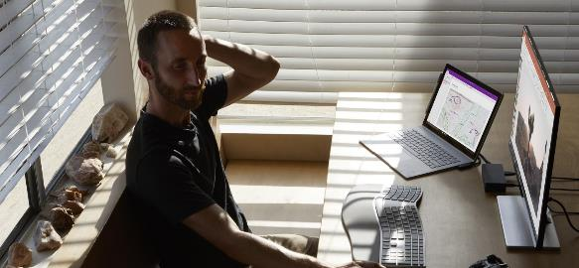
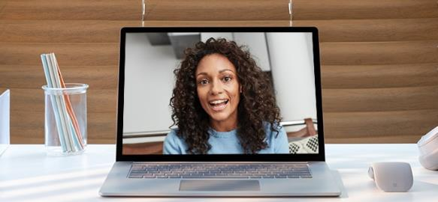
Location and lighting
Wardrobe
Take a moment to prepare your recording space.
An HD webcam is preferred, but a new PC or tablet will have a good camera
Your camera should be stable at, or slightly above, eye level
Make sure your face is in good, even light, with no harsh backlight In addition, avoid mixing light sources (e.g., window and lamp light) as the different color temperatures will show up in the video
Do not sit in front of a window. Your webcam will compensate, which will cause your face to look dim or dark.
Reduce clutter and distracting or bright images in the background
Consider what you plan on wearing and how that will show up to your audience. Make sure your wardrobe matches the tone of your presentation.
Please do NOT wear white
Solid colors work best
Avoid small prints, stripes, plaid or patterns
Unless otherwise specified, shirts with logos and trademarks should be avoided
Avoid noisy jewelry (necklaces, bracelets, earrings) as it can be distracting to the viewer
83
© Microsoft Corporation Microsoft 365

Slide 7


Audio quality
Audio equipment
Find a quiet location, sit for a minute and listen to your environment.
Can you hear noises in the hall, an air conditioner, or the buzz of a fan in your computer or laptop? These things can have an impact on the quality of your audio.
Try to pick a space that is smaller and with soft walls such as curtains. It will keep the sound from bouncing around which will make your audio sound hallow. Finally, make sure to turn off any nearby mobile devices.
For the best quality review your device options at https://aka.ms/TeamsDevices
It’s best to have a headset if possible. A USB mic is preferred.
Wired headsets can be a good alternative to the USB microphone. You will want to find a quality headset microphone that does not obstruct your face too much since your image will be visible in most cases.
Be sure to keep the headset microphone about a half inch off your face. Soft spoken words tend to get garbled for the listener on the other end. Speaking up and keeping your level consistent will also help listeners set their volume correctly.
84
© Microsoft Corporation Microsoft 365

Slide 8

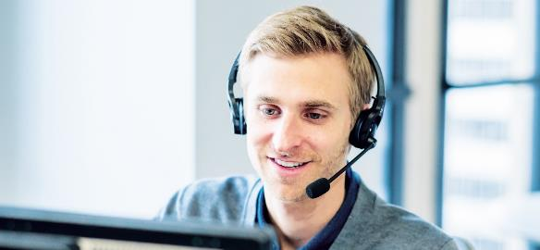
Presentation modes
Conversational speaking
How you present to your audience is important. Varying the source of information as you speak keeps your presentation dynamic and accommodates diverse learning needs.
Try to change presentation modes (talking to camera, video, PowerPoint, demo, video, interview, etc.) every 3-5 minutes. For example, if your presentation is heavy on PowerPoint, consider either adding a secondary element (i.e., video), or at least change back to camera every so often so that the audience can see you again and have a momentary change of pace and medium.
Remember that your audience is most likely at home watching you on a small screen. Sessions are much more intimate and on-demand now.
Speak with energy and with a tone of voice that you would normally have, as if you’re holding a conversation with some dear colleagues. Your time will go by quickly, as it always does. Keeping your content tight, focused and trying not to repeat yourself helps the audience stay engaged.
89
© Microsoft Corporation Microsoft 365

Slide 9
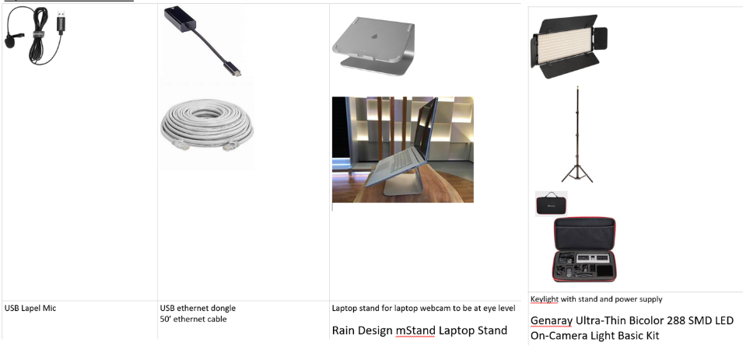
Example presenter kit
Good quality hardware will streamline your presentation experience not only for virtual events but for day to day video calls. These devices are examples only and similar items from different providers are also acceptable. Encourage Presenters to also consider Teams certified devices for the best audio experience.
85
© Microsoft Corporation Microsoft 365

Slide 10
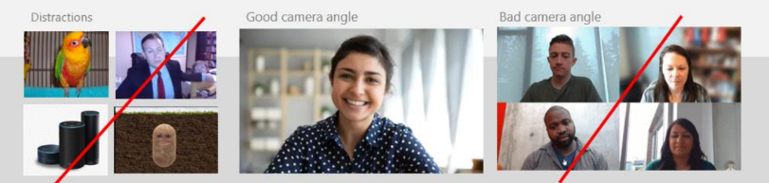
Checklist: recording from home
Presenting
Computer is plugged into a power outlet
Wired network connection is preferred
No one else should be on your WiFi during recording
Turn off your cell phone
Webcam that delivers a minimum 720p (ideally 1080p)
Invest in a good external microphone or speaker puck
Camera should be at or slightly above eye level
Backup of materials should be on your local computer
Teams background is ok to use
Computer
Clean up desktop
Hide the taskbar if showing desktop
If showing demo, 1920X1080 screen resolution
Use latest browser (Edge or Chrome)
Clear browser history or switch profiles
Close unnecessary applications
Turn off all notifications
Update your computer prior to your recording date or disable
Environment & Wardrobe
Record from a private room or location (avoid disruptions)
No harsh lighting on your face or behind you
Warm light (desk lamp) is preferred
Backdrop should be natural but uncluttered
Teams background effects are useful. Consider one for your event.
Solid or subtle pattern shirt appropriate for your audience
Avoid busy pattern, all white or grass-green shirts (for green screen effects)
86

Slide 11
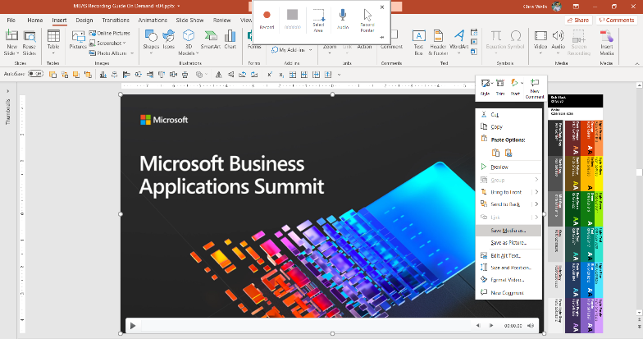
Recording – PowerPoint
1
3
2
To start recording within PowerPoint, open a new or blank presentation. On the Insert tab of the ribbon, select Screen Recording.
On the Control Dock, click on Select Area and either select the entire screen for recording or press Win Key+Shift+F. It is critical that the entire screen is selected.
PowerPoint automatically records the audio and mouse pointer. To turn them off, deselect Audio and Record Pointer in the Control Dock.
To start, click Record or use the following key commands:
Start recording: Win Key+Shift+R
Pause/resume: Win Key+Shift+R
Stop recording: Win Key+Shift+Q
When you’re finished recording, save your video. Right-click the inserted file on the slide that represents the recording and select Save Media as. In the dialog box, specify a filename and location.
Sample naming convention:
SESSIONCODE_SpeakerName_PRES.filetype
1
2
3
4
4
Tip: Unless you pin the Control Dock to the screen, it will slide up into the margin while you record. To make the unpinned Control Dock reappear, point the mouse cursor at the top of the screen.
87
© Microsoft Corporation Microsoft 365

Slide 12
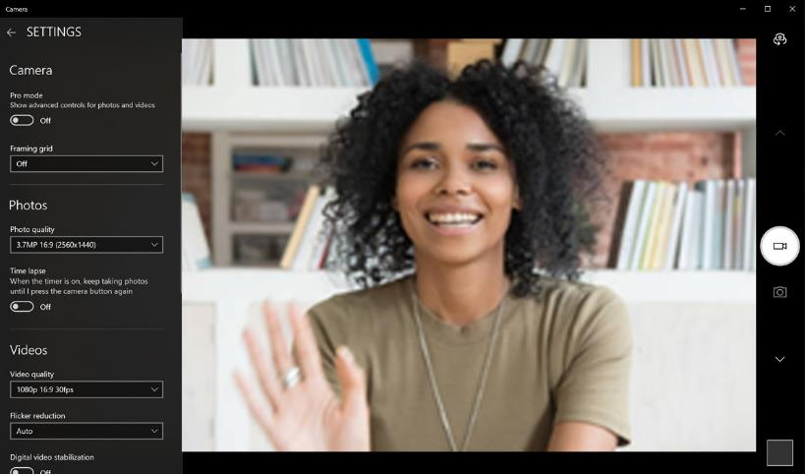

Recording – Windows 10 Camera App
1
App settings:
Search for “Camera” in Windows Search
Select “Camera App”
Make sure that “video quality” is set to 1080p 30fps in settings
Getting ready:
On the main navigation “Take Video” button. It may be defaulted to pictures. Set up your shot and center your face within the frame. Make sure you have good lighting, be careful of reflection in your glasses. Click the “Take Video” button again to record. Rename file & upload.
When complete, review your video in the lower right corner of the App or go the file location located in this folder C:\Users\username\Pictures\Camera Roll.
Sample naming convention:
SESSIONCODE_SpeakerName_CAM.filetype
2
2
3
1
3
88
© Microsoft Corporation Microsoft 365

Slide 13
Live Event Presenter experience
Presenter
During your event
92

Slide 14
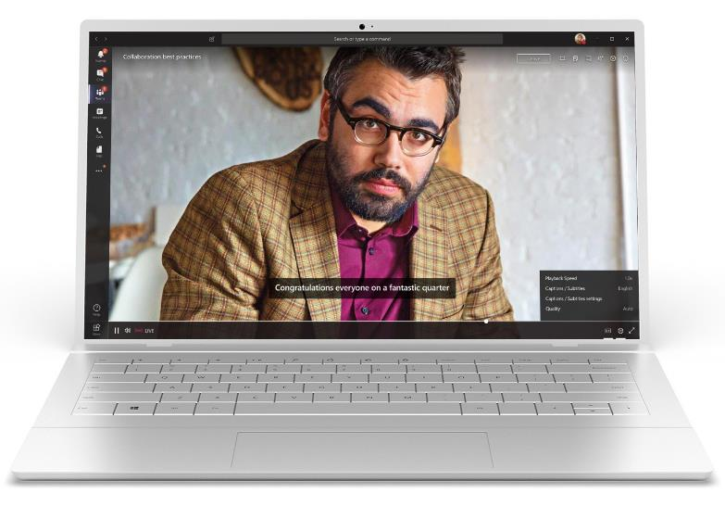
Machine setup
Hardwire your internet connection if possible
Clean desktop by hiding extra icons
Remove date and time from the system tray
Set resolution to 1920X1080
Set zoom level to 125%
Turn off windows updates
93
© Microsoft Corporation Microsoft 365

Slide 15
Software setup
Close any apps you are not using (Outlook, browsers, etc.)
Clear browser history or use separate demonstration profile
Preload necessary webpages
Turn off notifications
Remote date/time from the system task bar
Log in to the meeting using the appropriate credentials. They may be different from your day to day account depending on the event design.
Test audio, video, sharing and any background (Teams meeting)
Put yourself on mute until you begin
94
© Microsoft Corporation Microsoft 365

Slide 16

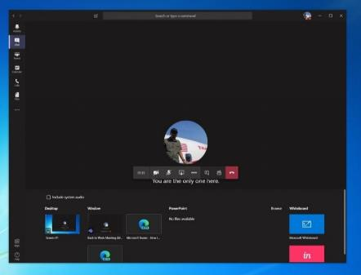
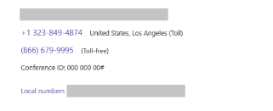

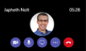
Live Event Presenter’s view
The Presenter role participates in the event with the ability to speak, present content and moderate the chat stream. It is a best practice to join in advance of the event to complete your final technical readiness check.
1
1
5
Select Join Microsoft Teams meeting in your meeting invite to be taken to a page where you can choose to either join on the web or download the desktop app. Please join via the full Teams application.
Make a note of the phone number and conference ID in the meeting invite, so you can dial the number to join in the case of connection loss.
Once you are on the Teams call, turn on your microphone, camera and share your desktop.
Make sure that the Teams panel is hidden out of the way on a second monitor or minimized.
Keep an eye on the Teams meeting chat on another monitor or another device. Moderators, producers and switching operators will use this chat to communicate with you during your session.
1
2
2
3
4
3
5
NOTE: You can only present in a Live Event from your Windows or Mac desktop device. There is no support for mobile presenting in Live Events at this time.
4
95
© Microsoft Corporation Microsoft 365

Slide 17
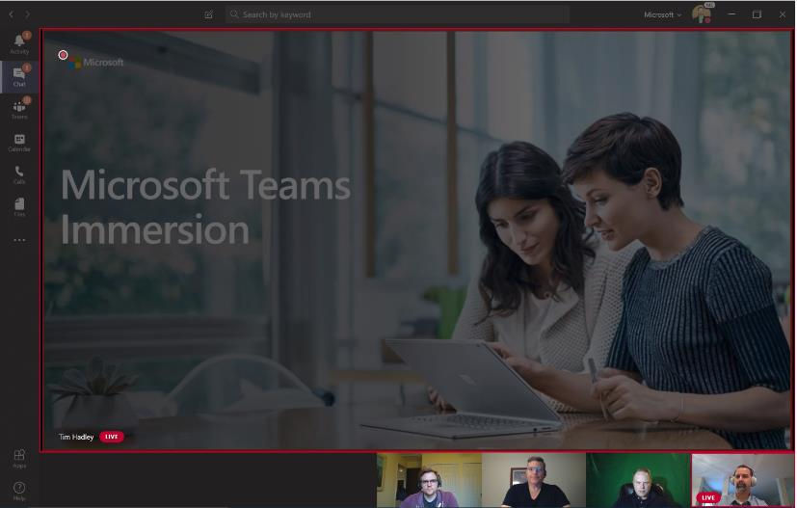
Live Event Presenter’s view While speaking and presenting
The red border indicates to the Presenter whose Camera is enabled and being shared.
96
© Microsoft Corporation Microsoft 365

Slide 18
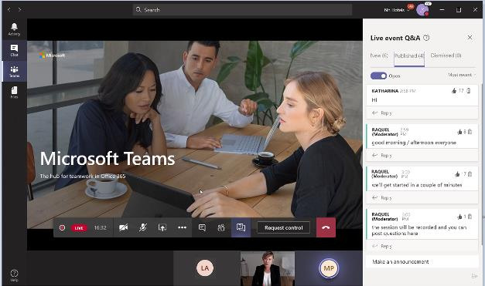
Live Event Presenter’s view – additional details
The Presenter role participates in the event with the ability to speak and present content and moderate Q&A (there will likely be multiple Presenters invited to the event). Presenters have access to a private chat during the event with the other Presenters and the Producer. This chat is not visible to the Attendees of the event.
Enable Chat Private to interact with the team of Moderators/ Producers
Keep this chat open throughout the event to coordinate with the team of Producers and Presenters privately. This chat will not be visible to Attendees.
Moderate the Attendees’ Q&A window
This window will display questions from Attendees during the event. Remember that Attendees do not have access to the microphone.
The Attendees’ questions will be deployed in the New tab. You can then publish it to the entire group of Attendees, which will move it to the Published tab, or keep your answer private.
You can also dismiss any redundant or out-of-context questions, which will move them to the Discarded tab.
Enable your Microphone and/or Camera to interact with the other Presenters and Producer View people who have connected to the Presenter or Producer role for the event. If they turn on their Camera, you can see your image.
Share your screen with the Producer
Share your screen with the Producer to finalize the event details. The Producer may present his/her screen at the Live Event if he/she wishes.
See the Producer and other Presenters
View people who have connected to the Producer or Presenter role for the event. If they turn on their Camera, you can see their image.
97
© Microsoft Corporation Microsoft 365

Slide 19
Teams meeting Presenter experience
Presenter
During your event
98

Slide 20
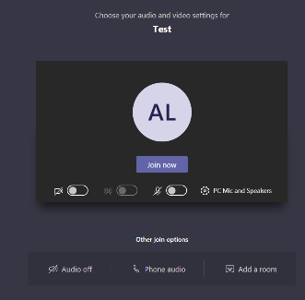
Screen prior to joining a Teams meeting
Next you will see the following screen, in which you will have the following selections prior to joining the meeting.
1
3
Camera
If you turn on your camera you may notice the icon below. This is to enable background effects. This will not be available if you are using the Teams web client.
Device settings
Select audio device and camera settings to make adjustments to your audio or camera source.
4
2
4
Microphone
If 3 or more people have already joined the meeting, you will be joining the meeting on mute. Select the slider to activate your microphone.
Join now Join and connect to audio using your computer speaker and microphone or a headset connected to your computer (wired/Bluetooth).
1
2
3
5
6
7
Other Join Options:
5
6
7
Audio off
Select this option when there’s already an active mic and speaker in the same room as you. This will ensure there is no echo.
Phone audio
Join and connect to audio using your desk phone or mobile phone. Video will only be displayed on screen. This includes:
“Call me” option
Information to dial in manually
Add a room
Join and connect audio to a conference room. Your device will connect without audio to prevent echoing.
99
© Microsoft Corporation Microsoft 365

Slide 21


Options available in meeting
Turn camera on/off | Show meeting chat
Mute/unmute sound | Show participants
Share screen: options include desktop, window, specific application | Hang up/leave meeting
More actions | Raise your hand
For more details on Share Screen and More Actions, refer to the next slides.
100
© Microsoft Corporation Microsoft 365

Slide 22
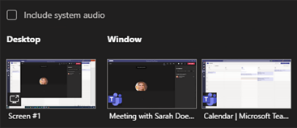
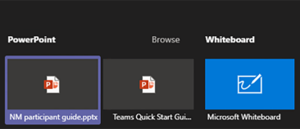
Share Screen icon
Select the Share Screen icon
Select what you want to share:
Desktop lets you show everything on your screen.
Window lets you show a specific app.
PowerPoint* lets you show a presentation.
Browse lets you find the file you want to show.
Whiteboard allows you draw/write on the screen.
After you select what you want to show, a purple border surrounds what you're sharing. Double click the item selected to start sharing.
A
B
A
B
C
D
C
D
E
E
Note that the Include System Audio box is unchecked by default. Check if you want to play a video or audio clip as part of a presentation.
*When sharing directly from PowerPoint, Word, etc. the audience may scroll through the pages independently of the presenter (without impacting the presentation). If you don’t want people to be able to independently navigate through the PowerPoint file you are sharing, select (it’s next to Stop presenting) to prevent it.
101
© Microsoft Corporation Microsoft 365

Slide 23
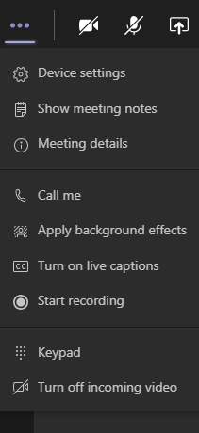
More Actions icon
1
Device Settings: Select audio device and camera settings. Set restrictions to allow parties to move through shared presentations on their own.
Show Meeting Notes: Notes you take are shared with others and are accessible before, during and after the meeting.
Meeting Details: Join meeting link info/ dial info.
Call Me: Transfer call to another device.
Apply Background Effects: Apply blur background or apply a custom background so participants in the meeting are not distracted by what’s going on behind you when your camera is turned on.
Turn On Live Captions: Live captions can make your meeting more inclusive to participants who are deaf or hard of hearing, people with different levels of language proficiency, and participants in a loud place.
Start Recording: When you record a meeting, a banner will appear, letting attendees know that the recording has begun. You can access the recording after the meeting ends in the meeting chat or in Stream.
Keypad: Dial out from the Teams meeting using the Teams Audio Conferencing Services.
Turn Off Incoming Video: Help the quality of the audio on incoming video by turning off video.
1
2
2
3
4
3
5
4
6
5
6
7
7
8
8
9
9
102
© Microsoft Corporation Microsoft 365

